Slide 1
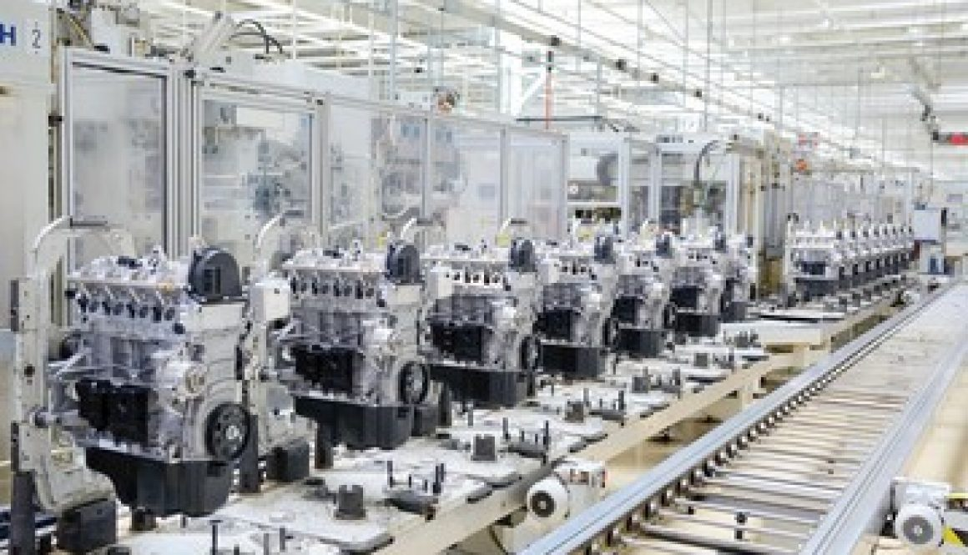
Car Manufacturing Cyber Resiliency
Alden Jettpace, Oluwafewa Ayodeji, & Khalfan Alneyadi

Slide 2
Intro + Background
Car and Car Parts Manufacturing has recently suffered a string of cyber attacks, including Ransomware
Almost ⅔’s of the supply chain is vulnerable to cyber attacks.
On February 28, 2022, a major automotive company announced the suspension of 28 operation lines in 14 plants in Japan due to the cyberattack on its automotive parts supplier

Slide 3
People
Robustness:
Training Courses, with incentives such as rewards
Redundancy:
Cross Training
Backup Teams
Resourcefulness:
Suggestion Boxes
Outside Security Professionals
Rapidity:
Specialized Response Teams
On-Call Employees

Slide 4
Processes
Robustness:
Electronics Script Testing
Minimum Security Requirements
Redundancy:
Lockout-Tagout (LOTO)
Expanding Suppliers/Customers
Resourcefulness:
Root Cause Analysis
Open Data Sharing Agreements
Rapidity:
Response-Plan Codes
Recovery Objectives

Slide 5
Technology
Robustness:
Data Encryption
Network Access Controls
Redundancy:
Cloud Data Backups
Redundant Implementation of ICS
Resourcefulness:
Security Information and Event Management (SIEM)
Alternative modes of Communication
Rapidity:
Intrusion Detection and Prevention Systems
Security Orchestration, Automation, and Response (SOAR)

Slide 6
What went right
Managed to find various solutions for inducing cyber resilience into the car manufacturing process
Gained a new understanding of the nature of the supply chain and its necessity in securing it as you would any tangible asset
Managed to work well with little contact, established system of trust on sections

Slide 7
What went wrong
Did not meet initial plans as stated in charter, regular meetings where phased out in favor of informal contact and system of trust
Focused responsibility of paper sections meant we did not learn together the different solutions, becoming specialized but losing a broader understanding of the solutions

